Slide 1
Information Systems Doctoral Application Information Session
2024

Slide 2
Welcome
Objectives for today’s session
About DSU
Discuss Application Process
Discuss Application Review Criteria and Process
Provide insights into a solid application
Answer your questions
This Photo by Unknown Author is licensed under CC BY-SA
This Photo by Unknown Author is licensed under CC BY-SA

Slide 3
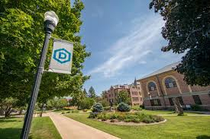
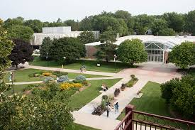
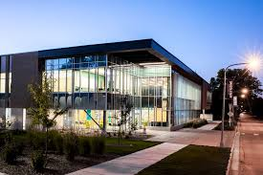
Est. 1881 as
Dakota Territory’s
First Teacher
Education College.
Now our Primary focus is Computer and
Information Sciences.
And, deeply infusing
Technology into all majors.
This Photo by Unknown Author is licensed under CC BY-SA
This Photo by Unknown Author is licensed under CC BY-SA

Slide 4
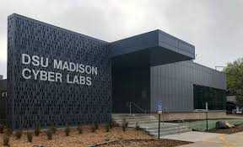
Charter designee of National Center of Academic Excellence in Information Assurance Education (2004, NSA)
Currently holding four distinctions with the DHS/NSA as a national Center of Academic Excellence in:
- Cyber Defense - Research - Cyber Operations
Information Systems first Ph.D. approved at DSU, Apr. 2004

Slide 5
Graduate Programs
Masters Ph.D.
Applied Analytics and Artificial Intelligence Information Systems
Artificial Intelligence Computer Science
Business Administration Cyber Defense
Computer Science Cyber Operations
Cyber Defense
Educational Technology
Health Informatics and Information Management
Information Systems
This Photo by Unknown Author is licensed under CC BY-SA
This Photo by Unknown Author is licensed under CC BY-SA

Slide 6
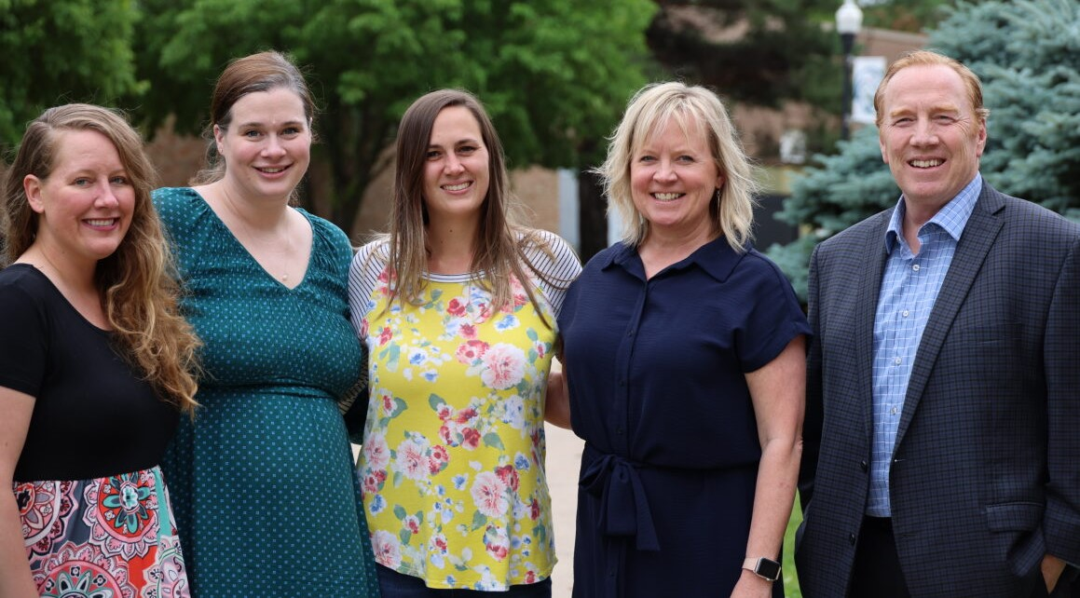

Slide 7
Patrick Engebretson, Ph.D.
Assoc. Professor, Coordinator, Ph.D in Cyber Operations
The Beacom College of Computer and Cyber Sciences
This Photo by Unknown Author is licensed under CC BY-SA
This Photo by Unknown Author is licensed under CC BY-SA

Slide 8
What’s New with the Ph.D.CD Doctoral Application Process?
No GRE
No Letters of Recommendation
Not a “Goal Statement” but a “Purpose Statement”
Fall 2024 applications due Sept. 30, 11:59 pm.
Application completely online: DSU.edu/apply > Graduate Admissions > Register > Login > Apply

Slide 9
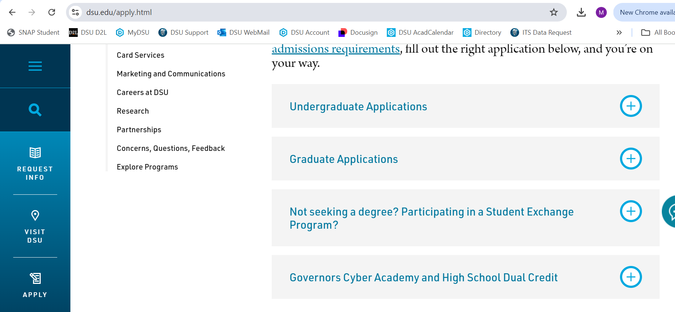

Slide 10
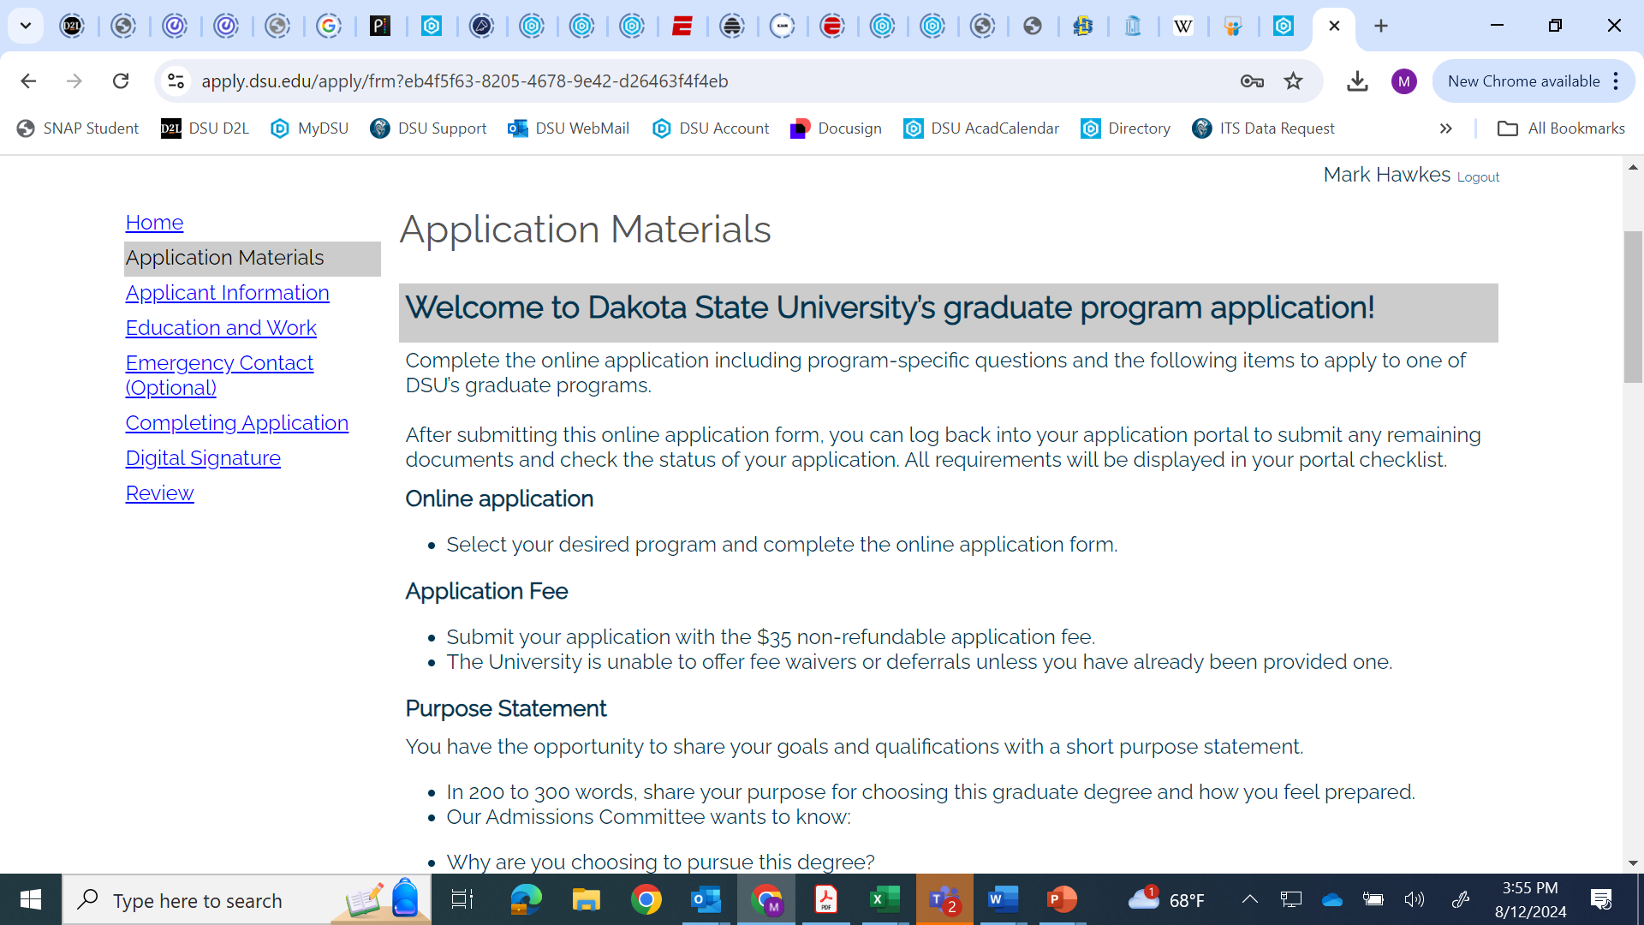

Slide 11
Creating Strong Applications
Show how educational history applies
Describe relevant background and expertise
Focused writing, clear explanations, lucid descriptions
Include only significant and relevant employment
Make sure your background and/or interests match up with the right DSU program
Write/Apply from the perspective of the program to which you are applying
Have a requirement for a computer science undergraduate or MS degree—assuming understanding of programming and structures (Stress this in the Application).
What other academic research, hobbies, teaching that related to Cyber Operations—about highlighting technical abilities

Slide 12
Post-Application
Application Portal will confirm all materials received.
Don’t ignore prompts or cues—especially about transcripts
Application review
First time for a Fall cohort
Targeting Nov. 15 for acceptance notifications (or there about)
Review Criteria
Undergraduate preparation, relevance of graduate work, professional work and skillset, alignment of undergraduate—MS—and/or work expertise with Ph.D. degree program

Slide 13
“Powerhouse on the Prairie” Uniqueness
Online expertise
Online student support services
Dissertation Development
Mentorship Model
How is the dissertation problem framed and addressed?
What are the research themes (topics)?
How does creativity emerge?
Remote Graduate Research
Collaborative Research and enduring network

Slide 14
Questions?

